Slide 1
Elite Emergency Response Inc
Medical Staffing~Training~Education
Media Kit

Slide 2
Founded by Stephani Laing ACP, who began doing private event standby work in 2003.
While working as an onsite EMT for Cirque De Soleil the first year it came to Calgary, she saw a need for quality onsite EMS staff at special events to handle emergencies and injuries while waiting for ambulance response.
After years of success & growth to become an industry leader, Elite incorporated in 2016.

Slide 3
After starting with show-jumping & equestrian events, Elite has also branched into:
Triathlons
Cultural Festivals
Charity walks & 5ks
Concerts
EDM Music Festivals
Private Parties
Rodeos
Motocross
Horse shows of all varieties
Any public or private gathering

Slide 4
Some Past & Present Elite Clients:
Anderson Ranch
Wildwood Equestrian Park
Astral Harvest Music Festival
Motion Notion Music Festival
Freezerburn Music Festival
Calgary Greek Festival
Oh Canada Restaurant & Bar
Virgin Music Fest 2008
Springbank Pony Club
X-Weighted (TV show)
Multisports Canada
Fort Calgary
CIBC Run For the Cure
Pengrowth Corporation

Slide 5
Why Elite Emergency Response Inc Leads the Industry
High standards for staff, training, professionalism
Recipient of a Priory Vote of Thanks from the Order of Canada for expertise in training & adult education
Advanced & Primary Care Paramedics, RNs with years of field experience
Ongoing training & education
Staff are mentored for years before working independently
Personable & engaging, excellent representatives of any event/organization
Uses ‘edutainment’ in public training courses; if you’re laughing you’re learning!
Clients enjoy staff consistency; very low staff turnover
Education in mental health, sports medicine, kinesiology, psychology, crisis intervention
Proactive & preventative approach to health and safety
Their mission is to make exceptional onsite medical care and training accessible & affordable for all

Slide 6
Services
Onsite EMS staff for events, gatherings, or private clients
First aid & CPR courses taught be experienced medical professionals
CPR training for laypersons & medical personnel
Targeted, tailored training courses for first responders
First Aid training for both public and private groups
Safety assessment and planning
Public education
Expert consultations and technical advising

Slide 7
Testimonials:
“Elite Emergency Response is right – these guys have the experience, the expertise, and the knowledge to provide the right response at the right time. As a bonus, they are wonderfully caring people that have dedicated their time to making the world better and to the safety and health of others. Considering the amount of benefit they can provide I wouldn’t hesitate to try to book this team for any event over 500 people, or smaller if you have the budget for it. Thankfully their rate is very reasonable.”
J Good, Reign Bough Fiddle Festival
Can't thank Stephani and Cam enough for the services they provide, as well as the smiles and positive energies they bring with them. D Shadda, festival guest
Very respectful of patient confidentiality, in tune with specific needs, very professional when dealing with a crisis, as well as amazing at wrapping an ankle or 2. Would recommend them to anyone and everyone for any medical standby needs or training. No job too big or small for this fantastic crew. I’ve admired the work they do and respect them. Never a second thought on any medical need from them.
Jason D., event guest/patient
I love Stephani and her crew! I am forever grateful for this team, not only for the essential service that they continue to provide our festival (since 2008), but also for their ability to connect with the attendees in an authentic manner. Their extensive knowledge and on-point care and service helps to create a safe and thriving environment.
Petra S., Astral Harvest Festival

Slide 8
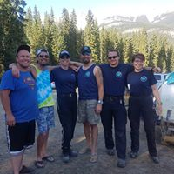
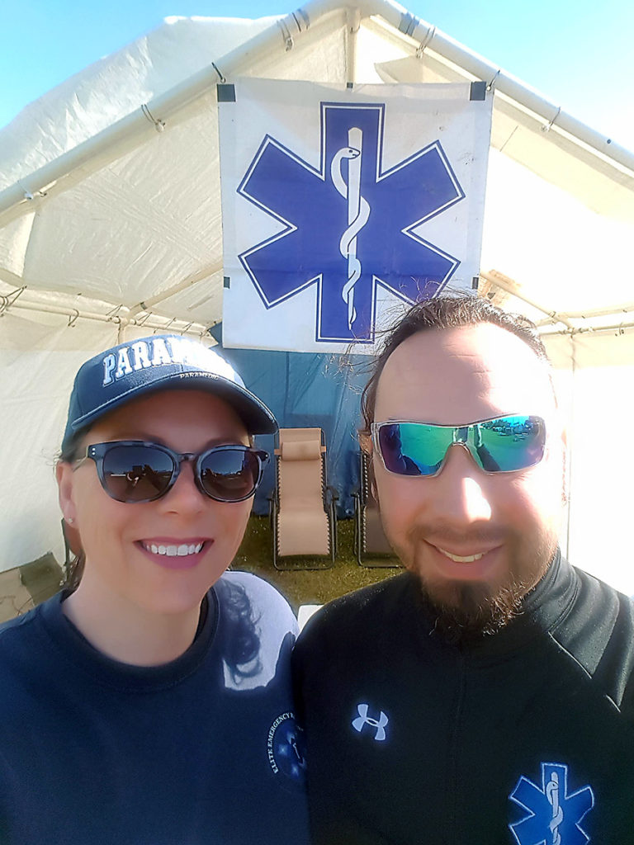
Cameron Doore COO/ACP Stephani Laing CEO/ACP
Laura Piercey, PCP Ryley Bennet, HR/PCP
Jody Stoltz, PCP
Stephani Laing, CEO/ACP & Cameron Doore, COO/PCP
Click here to download
Elite Emergency Response can be found on:
Facebook: www.facebook.com/EliteResponse
Instagram: Eliteemergencyresponse
Web: www.eliteems.ca
www.eliteemergencyresponse.com
Media inquiries and requests can be sent to: media@eliteemergencyresponse.com

